Slide 1



Recognizing and Avoiding Phishing Attacks
By: Ibrahem Ali

Slide 2
Agenda
Definition
Common phishing techniques
Tips for recognizing phishing email
Indicators of a phishing website
How You Protect yourself ?

Slide 3

Introduction
What is phishing?
A technique for attempting to acquire sensitive data, such as bank account numbers , through a fraudulent solicitation in email or on a web site , in which the perpetrator masquerades as a legitimate business or reputable person.
3

Slide 4
Common Phishing Techniques
Email Phishing : Fake emails that appear to be from legitimate sources, asking users to provide personal information or click on malicious links.
Social Engineering : Manipulative tactics used to trick individuals into revealing sensitive information or performing actions that benefit the attacker.
Vishing : Vishing or “voice phishing” is a phishing attack performed over the phone , vishers attempt to talk their targets into handing over sensitive information such as credit card details.
4

Slide 5
Tips For Recognizing Phishing Attack
Verify the authenticity of websites by checking the URL, security indicators, and reviewing the design and content.
Check your accounts regularly to ensure that no changes have been made without your knowledge.
Be vigilant and skeptical of unsolicited emails, especially those requesting sensitive information.
Think twice before sharing personal information or clicking on suspicious links.
Pay attention to warning signs such as poor grammar, misspellings, and generic greetings.
5

Slide 6
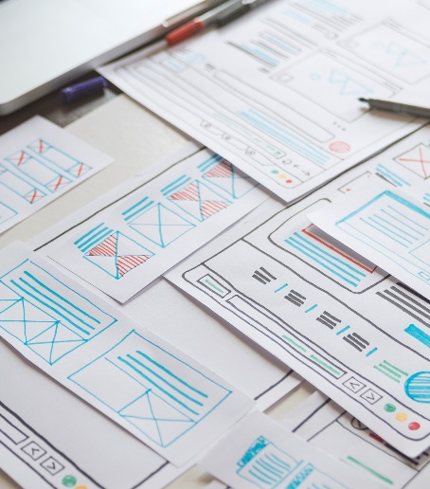
Indicators of Phishing Attack
Look for signs of a suspicious website:
- Incorrect URL or domain name
Poor website design and layout
Missing security indicators (e.g., padlock icon)
Requests for sensitive information on unsecured pages
6

Slide 7

How you Protect yourself from Phishing Attacks
1- Keep software and antivirus programs up to date.
2- Enable two-factor authentication whenever possible.
3- Educate yourself and others about phishing techniques.
4- Report phishing attempts to the appropriate authorities or your organization’s IT department.
7

Slide 8




Thank you
Ibrahem Ali
ibrahem.ali.ibrahem5555@gmail.com

